Slide 1
Chapter 9: Implementing the Cisco Adaptive Security Appliance
CCNA Security v2.0

Slide 2
Chapter Outline
9.0 Introduction
9.1 Introduction to the ASA
9.2 ASA Firewall Configuration
9.3 Summary

Slide 3
Section 9.1: Introduction to the ASA
Upon completion of this section, you should be able to:
Compare ASA solutions to other routing firewall technologies.
Explain ASA 5505 operation with the default configuration.
Cisco provides two firewall solutions: the firewall-enabled ISR and the Cisco Adaptive Security Appliance (ASA).

Slide 4
Topic 9.1.1: ASA Solutions

Slide 5
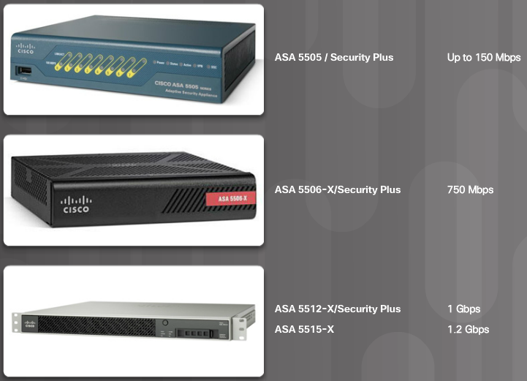
ASA Firewall Models
An IOS router firewall solution is appropriate for small branch deployments and for administrators who are experienced with Cisco IOS. However, an IOS firewall solution does not scale well and typically cannot meet the needs of a large enterprise.
The choice of ASA model depends on an organization’s requirements, such as maximum throughput, maximum connections per second, and budget.
Small Office and Branch Office ASA Models
Notes:
9.1.1.1 ASA Firewall Models

Slide 6
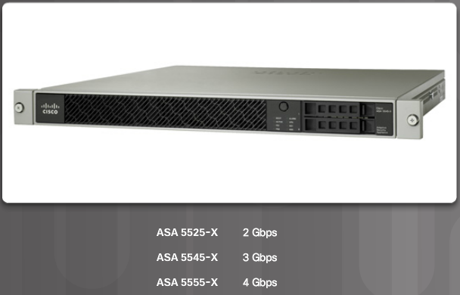
ASA Firewall Models (Cont.)
Internet Edge Models
Notes:
9.1.1.1 ASA Firewall Models (Cont.)

Slide 7
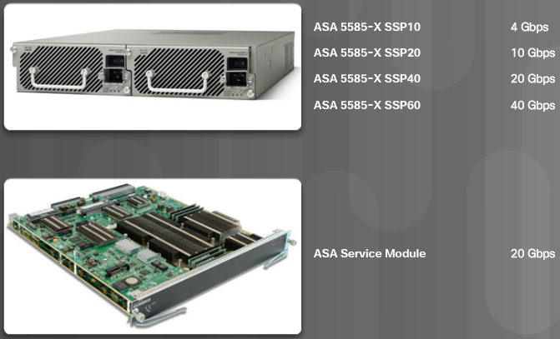
ASA Firewall Models (Cont.)
Enterprise Data Center Models
Notes:
9.1.1.1 ASA Firewall Models (Cont.)
9.1.1.2 Cisco ASA Next-Generation Firewall Appliances: Video - Introducing Cisco ASA with FirePOWER Services

Slide 8
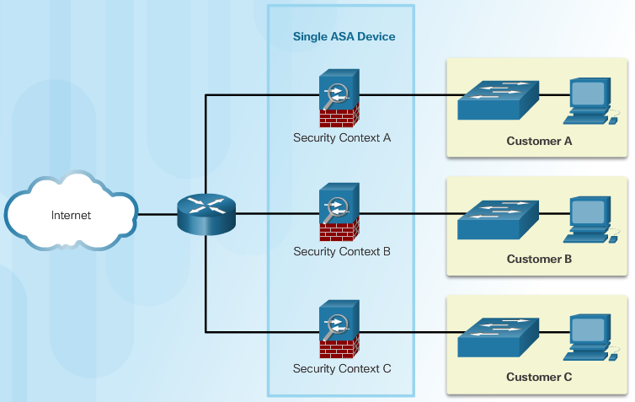
Advanced ASA Firewall Feature
ASA Virtualization
A single ASA can be partitioned into multiple virtual devices
Notes:
9.1.1.3 Advanced ASA Firewall Feature

Slide 9
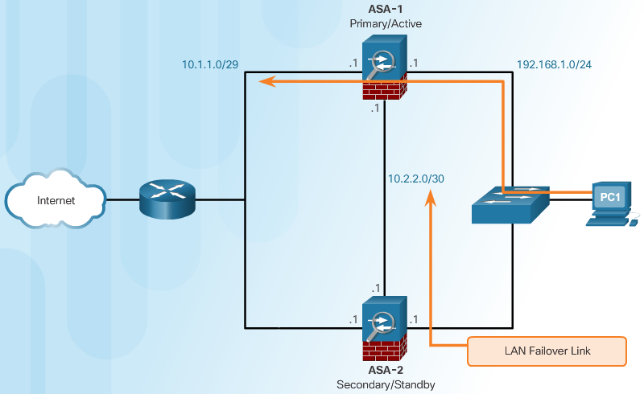
Advanced ASA Firewall Feature (Cont.)
As shown in Figure 2, two identical ASAs can be paired into an active / standby failover configuration to provide device redundancy.
High Availability
Notes:
9.1.1.3 Advanced ASA Firewall Feature (Cont.)

Slide 10
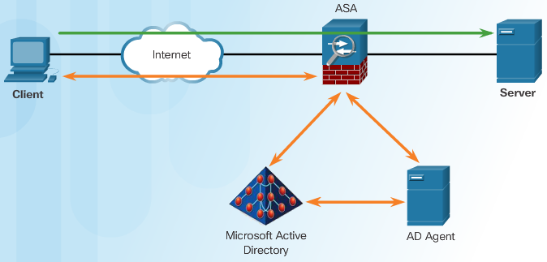
Advanced ASA Firewall Feature (Cont.)
The ASA provides optional, granular access control based on an association of IP addresses to Windows Active Directory login information. For example, in Figure 3, when a client attempts to access the server resources, it must first be authenticated using the Microsoft Active Directory Identity-based firewall services.
Identity Firewall
Notes:
9.1.1.3 Advanced ASA Firewall Feature (Cont.)

Slide 11
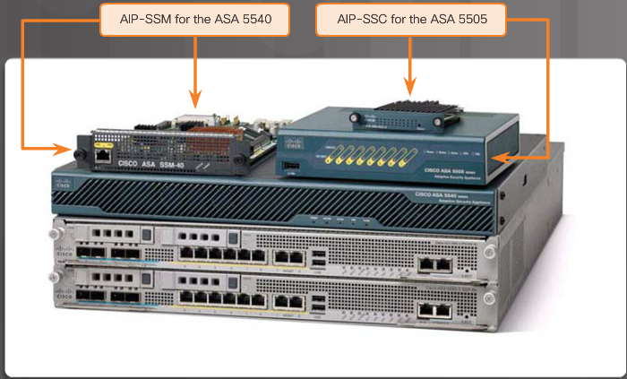
Advanced ASA Firewall Feature (Cont.)
ASA Threat Control
All ASA models support basic IPS features. However, advanced IPS features can only be provided by integrating special hardware modules with the ASA architecture. IPS capability is available using the Advanced Inspection and Prevention (AIP) modules.
he Cisco Advanced Inspection and Prevention Security Services Module (AIP-SSM) and Cisco Advanced Inspection and Prevention Security Services Card (AIP-SSC), shown in Figure 4, deliver protection against tens of thousands of known exploits. They also protect against millions of other unknown exploit variants using specialized IPS detection engines and thousands of signatures.
Notes:
9.1.1.3 Advanced ASA Firewall Feature (Cont.)

Slide 12
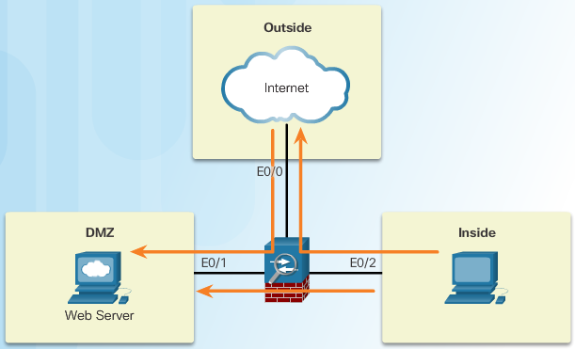
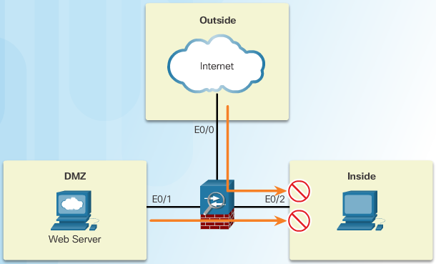
Review of Firewalls in Network Design
Permitted Traffic
When discussing networks connected to a firewall, there are some general terms to consider:
Outside network - Network/zone that is outside the protection of the firewall
Inside network - Network/zone that is protected and behind the firewall
DMZ - Demilitarized zone that allows both inside and outside users access to protected network resources
Denied Traffic
Notes:
9.1.1.4 Review of Firewalls in Network Design

Slide 13
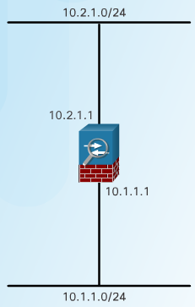
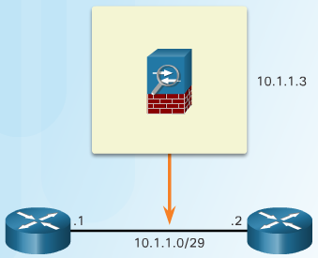
ASA Firewall Modes of Operation
Routed Mode
Transparent Mode
Routed Mode - Two or more interfaces separate Layer 3 networks, i.e. domains. In Figure 1, the ASA is considered to be a router hop in the network and can perform NAT between connected networks.
Transparent Mode - Often referred to as a “bump in the wire,” or a “stealth firewall” because the ASA functions like a Layer 2 device and is not considered a router hop. In Figure 2, the ASA is only assigned an IP address on the local network for management purposes.
Notes:
9.1.1.5 ASA Firewall Modes of Operation

Slide 14
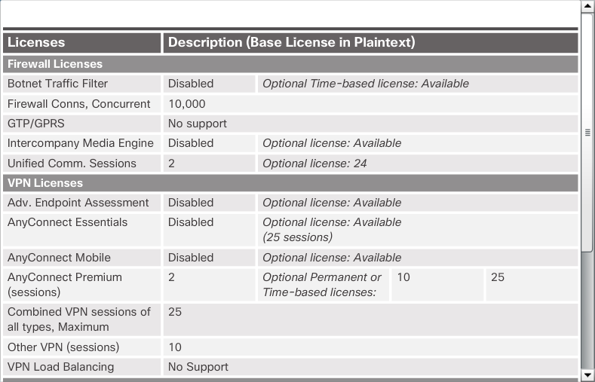
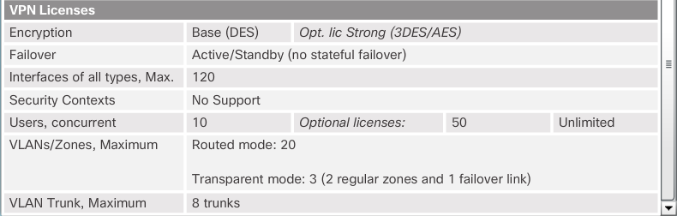
ASA Licensing Requirements
Base License Specifics
General Licenses
Notes:
9.1.1.6 ASA Licensing Requirements

Slide 15
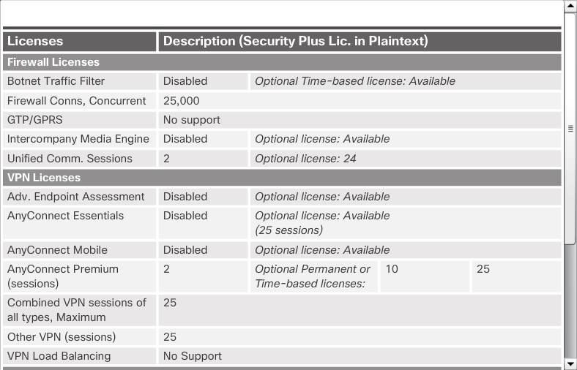

ASA Licensing Requirements (Cont.)
Security Plus License Specifics
General Licenses
Notes:
9.1.1.6 ASA Licensing Requirements (Cont.)

Slide 16
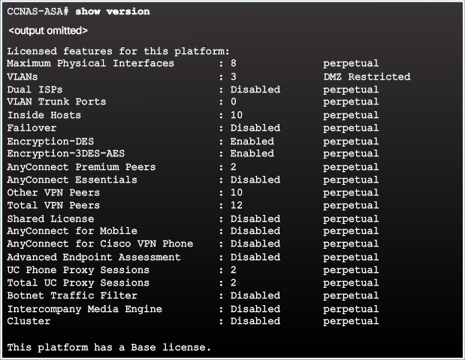
ASA Licensing Requirements
show version Command Output
Notes:
9.1.1.6 ASA Licensing Requirements

Slide 17
Topic 9.1.2: Basic ASA Configuration

Slide 18
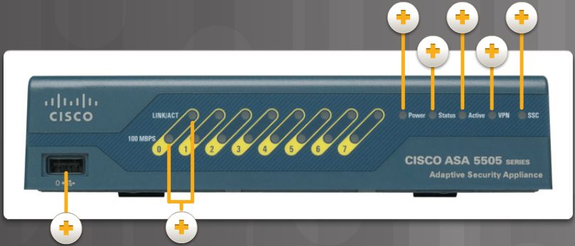
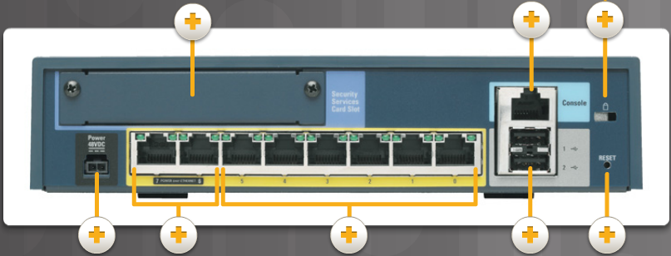
Overview of ASA 5505
ASA 5505 Back Panel
ASA 5505 Front Panel
Notes:
9.1.2.1 Overview of ASA 5505

Slide 19
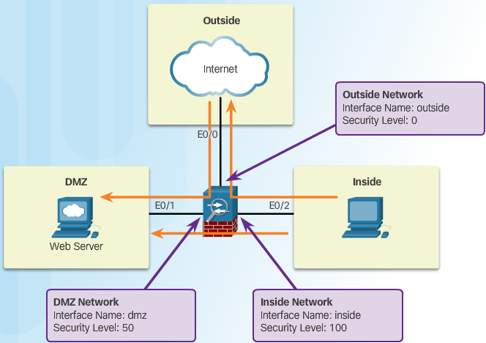
ASA Security Levels
The ASA assigns security levels to distinguish between inside and outside networks. Security levels define the level of trustworthiness of an interface. The higher the level, the more trusted the interface. The security level numbers range from 0 (untrustworthy) to 100 (very trustworthy). Each operational interface must have a name and a security level from 0 (lowest) to 100 (highest) assigned.
Security Level Control:
Network Access
Inspection Engines
Application Filtering
Notes:
9.1.2.2 ASA Security Levels

Slide 20
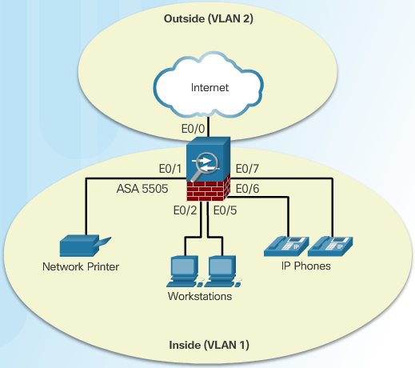
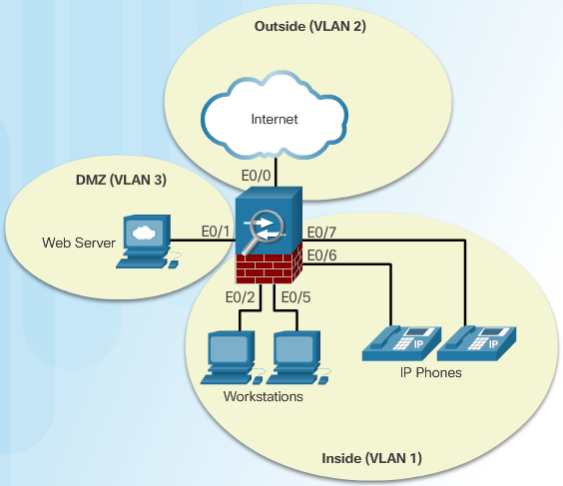
ASA 5505 Deployment Scenarios
ASA Deployment in a Small Branch
The ASA 5505 is commonly used as an edge security device. It connects a small business to an ISP device, such as a DSL or cable modem, for access to the Internet. It can be deployed to interconnect and protect several workstations, network printers, and IP phones.
ASA Deployment in a Small Business
Notes:
9.1.2.3 ASA 5505 Deployment Scenarios

Slide 21
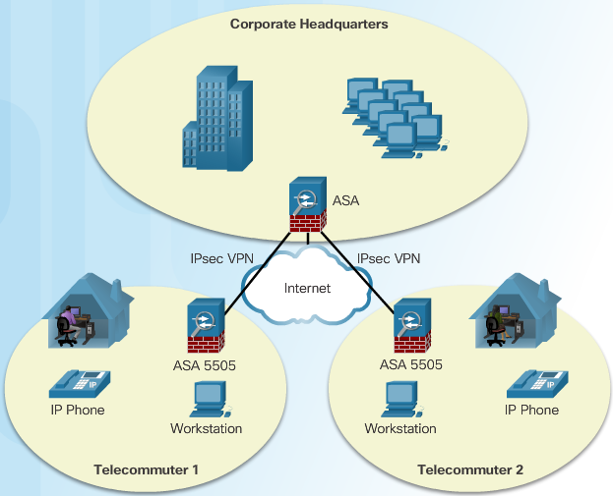
ASA 5505 Deployment Scenarios (Cont.)
ASA Deployment in an Enterprise
Notes:
9.1.2.3 ASA 5505 Deployment Scenarios (Cont.)

Slide 22
Section 9.2: ASA Firewall Configuration
Upon completion of this section, you should be able to:
Explain what ASA firewall services are enabled using the default configuration.
Configure an ASA to provide basic firewall services.
Configure object groups on an ASA.
Configure access lists with object groups on an ASA.
Configure an ASA to provide NAT services.
Configure access control using the local database and AAA server.
Explain how the Cisco Modular Framework (MPF) is used to configure ASA policies.

Slide 23
Topic 9.2.1: The ASA Firewall Configuration

Slide 24
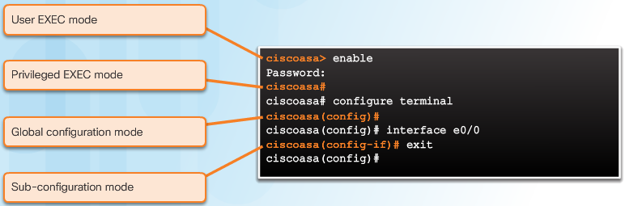
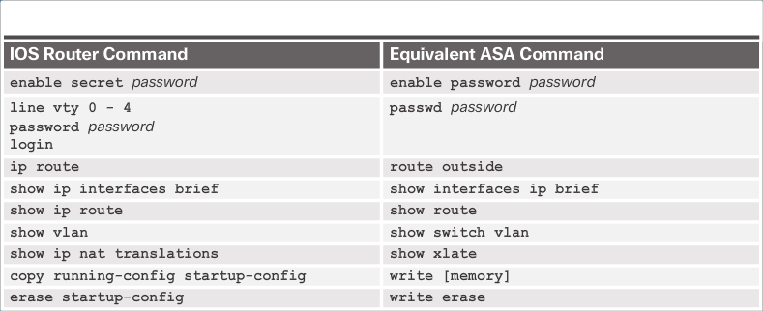
Introduce Basic ASA Settings
The ASA command line interface (CLI) is a proprietary OS, which has a similar look and feel to the router IOS. For example, the ASA CLI contains command prompts similar to that of a Cisco IOS router, as shown in Figure 1.
Base License Specifics
Security Plus License Specifics
Notes:
9.2.1.1 Introduce Basic ASA Settings

Slide 25
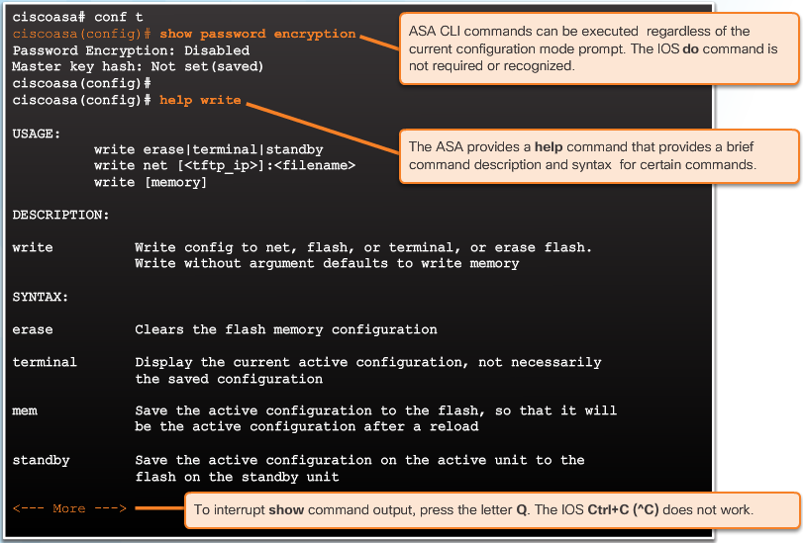
Introduce Basic ASA Settings (Cont.)
show version Command Output
Notes:
9.2.1.1 Introduce Basic ASA Settings (Cont.)

Slide 26
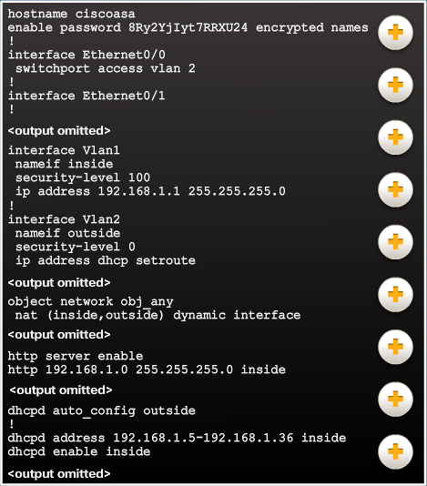
ASA Default Configuration
ASA 5505 Default Configuration Overview.
The ASA 5505 ships with a default configuration that, in most instances, is sufficient for a basic SOHO deployment.
Note: The ASA can be restored to its factory default configuration by using the configure factory-default global configuration mode command.
Notes:
9.2.1.2 ASA Default Configuration

Slide 27
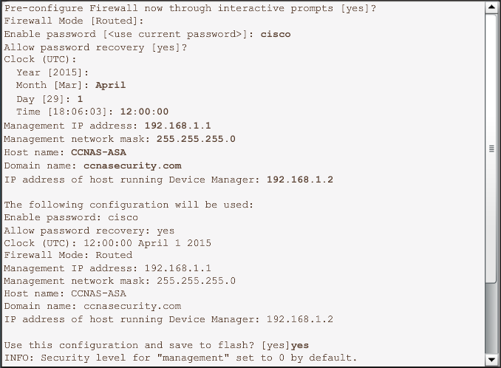
ASA Interactive Setup Initialization Wizard
Entering the ASA 5505 Setup Initialization Wizard
Notes:
9.2.1.3 ASA Interactive Setup Initialization Wizard

Slide 28
Topic 9.2.2: Configuring Management Settings and Services

Slide 29
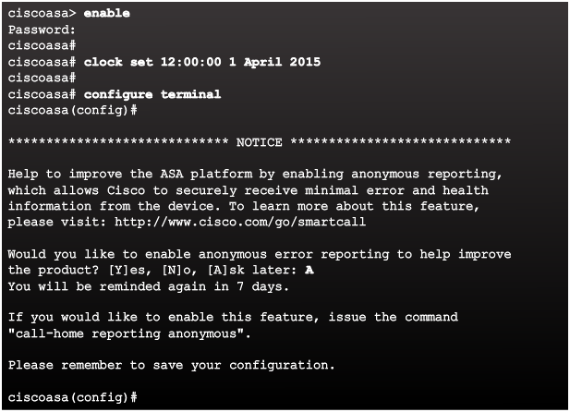
Enter Global Configuration Mode
The default ASA user prompt of ciscoasa> is displayed when an ASA configuration is erased, the device is rebooted, and the user does not use the interactive setup wizard.
To enter privileged EXEC mode, use the enable user EXEC mode command. Initially, an ASA does not have a password configured; therefore when prompted, leave the enable password prompt blank and press Enter.
The ASA date and time should be set either manually or by using Network Time Protocol (NTP). To set the date and time, use the clock set privileged EXECcommand
Entering Global Configuration Mode Example
Notes:
9.2.2.1 Enter Global Configuration Mode

Slide 30
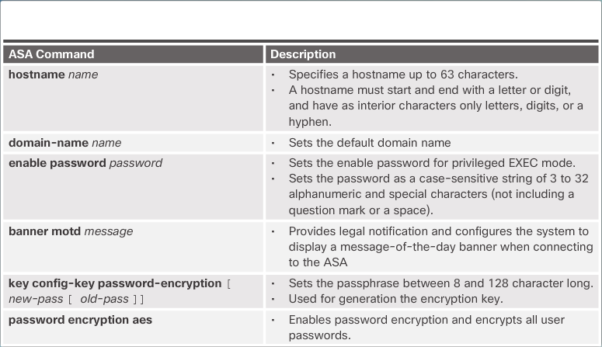
Configuring Basic Settings
ASA Basic Configuration Commands
Notes:
9.2.2.2 Configuring Basic Settings

Slide 31
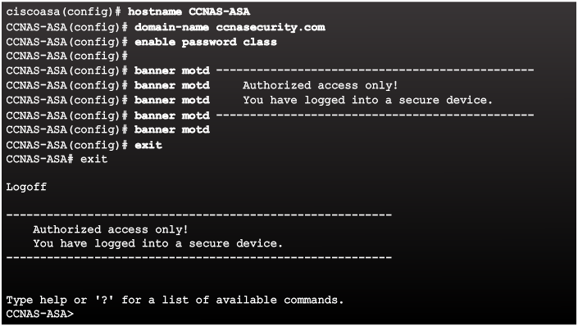
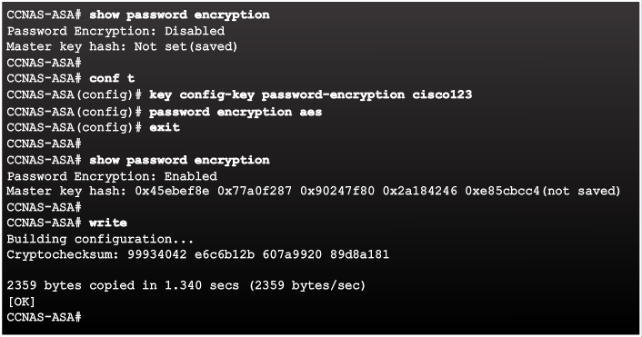
Configuring Basic Settings (Cont.)
Configuring Basic Settings
Enabling AES Encryption Example
Notes:
9.2.2.2 Configuring Basic Settings (Cont.)

Slide 32
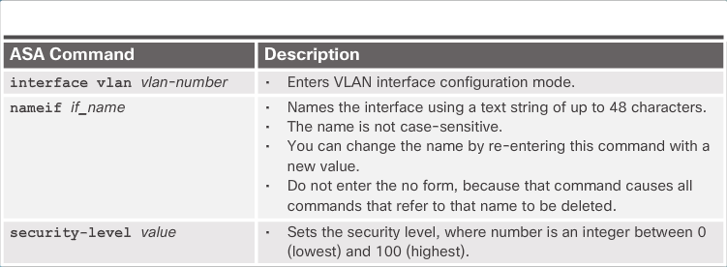
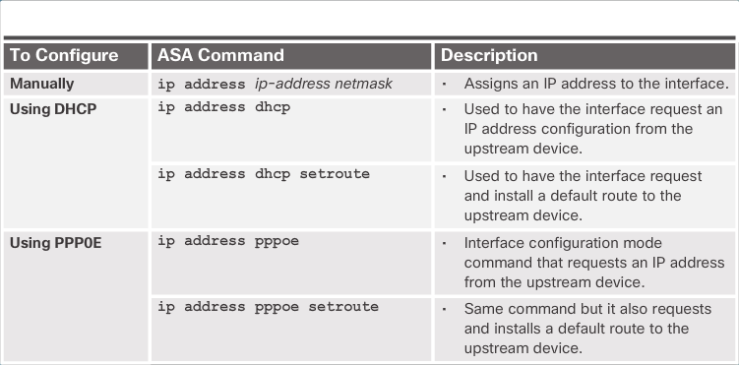
Configuring Logical VLAN Interfaces
Local VLAN Interface Commands
Configuring IP Addresses on VLAN Interfaces
Notes:
9.2.2.3 Configuring Logical VLAN Interfaces

Slide 33
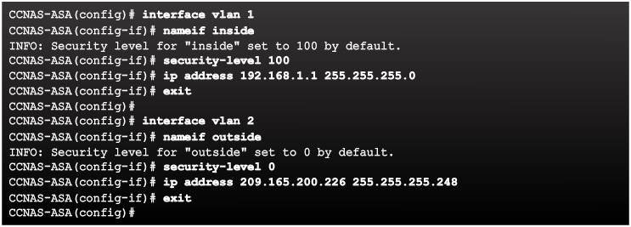
Configuring Logical VLAN Interfaces (Cont.)
Configuring VLAN Interfaces Example
Notes:
9.2.2.3 Configuring Logical VLAN Interfaces (Cont.)

Slide 34
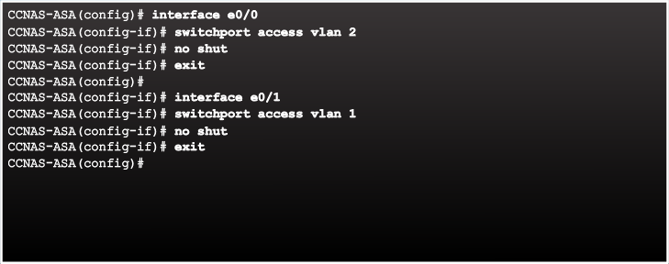
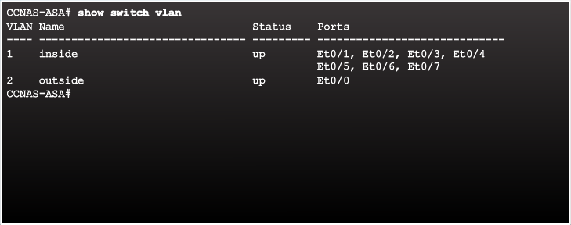
Assigning Layer 2 Ports to VLANs
Configuring Layer 2 Ports Example
Verifying VLAN Port Assignment Example
Notes:
9.2.2.4 Assigning Layer 2 Ports to VLANs

Slide 35
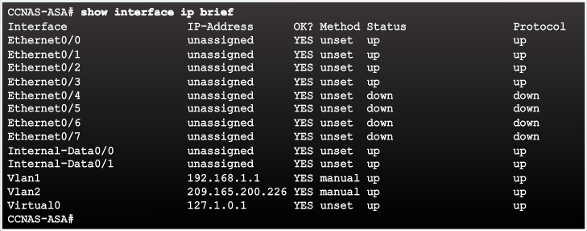
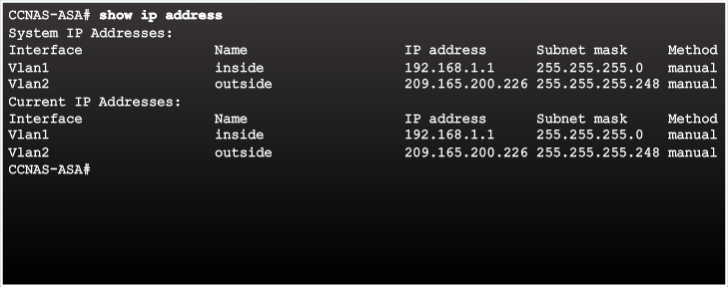
Assigning Layer 2 Ports to VLANs (Cont.)
Verifying Interfaces Example
Verifying IP Addresses Example
Notes:
9.2.2.4 Assigning Layer 2 Ports to VLANs (Cont.)

Slide 36
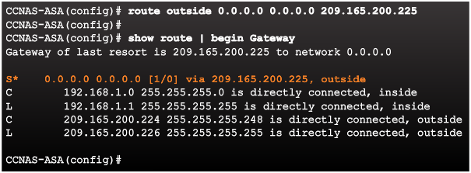
Configuring a Default Static Route
Notes:
9.2.2.5 Configuring a Default Static Route

Slide 37
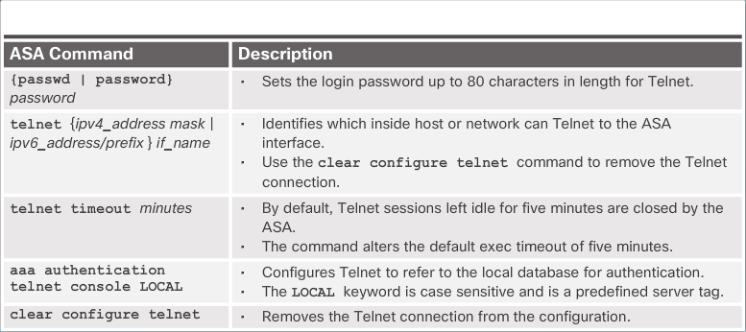
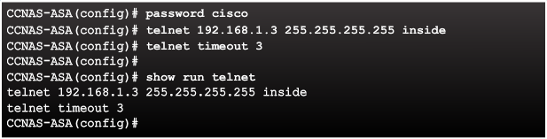
Configuring Remote Access Services
Telnet Configuration Commands
Telnet Configuration Commands Example
Notes:
9.2.2.6 Configuring Remote Access Services

Slide 38
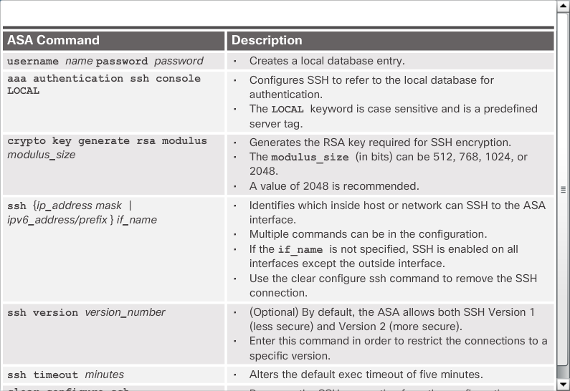
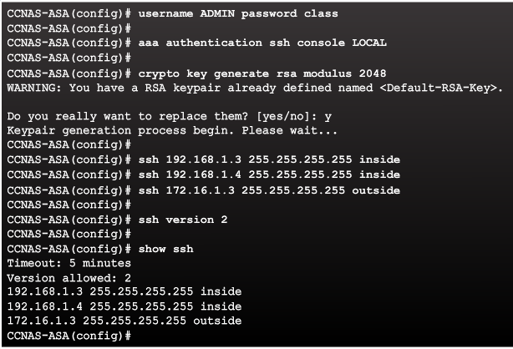
Configuring Remote Access Services (Cont.)
SSH Configuration Commands
Configuring SSH Access Example
Notes:
9.2.2.6 Configuring Remote Access Services (Cont.)

Slide 39
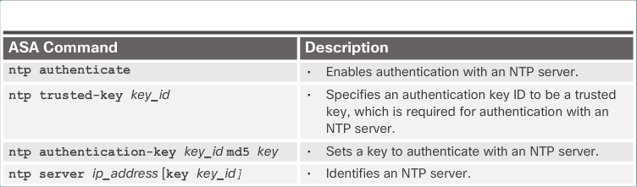
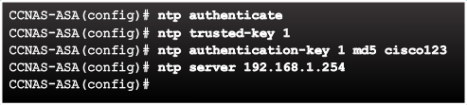
Configuring Network Time Protocol Services
NTP Authentication Commands
Configuring NTP Example
Notes:
9.2.2.7 Configuring Network Time Protocol Services

Slide 40
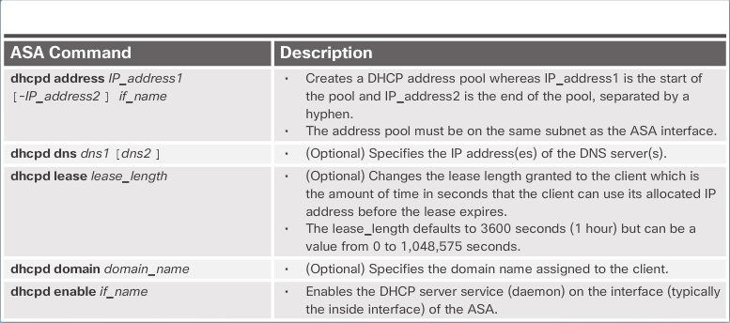
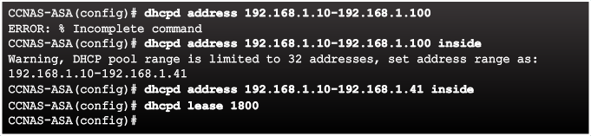
Configuring DHCP Services
DHCP Server Commands
Configuring DHCP Server Example
Notes:
9.2.2.8 Configuring DHCP Services

Slide 41
Topic 9.2.3: Object Groups

Slide 42
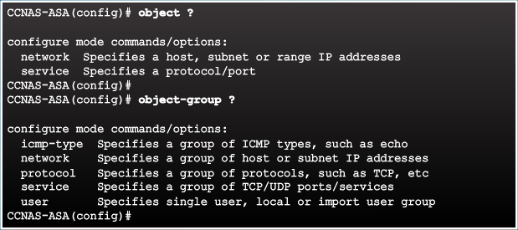
Introduction to Objects and Object Groups
Notes:
9.2.3.1 Introduction to Objects and Object Groups

Slide 43
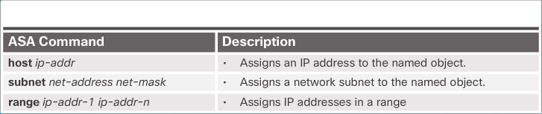
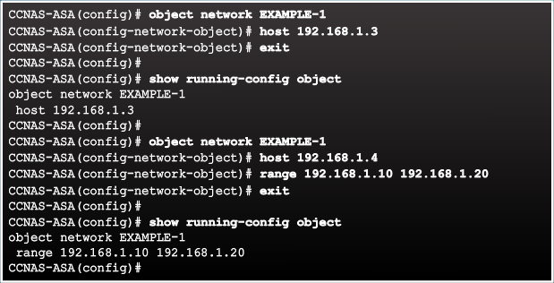
Configuring Network Objects
The ASA supports objects and object groups, as shown in the output in the figure.
Objects are created and used by the ASA in place of an inline IP address in any given configuration. An object can be defined with a particular IP address, an entire subnet, a range of addresses, a protocol, or a specific port or range of ports. The object can then be re-used in several configurations.
The advantage is that when an object is modified, the change is automatically applied to all rules that use the specified object. Therefore, objects make it easy to maintain configurations.
A network object name can contain only one IP address and mask pair. Therefore, there can only be one statement in the network object. Entering a second IP address/mask pair replaces the existing configuration.
Network Object Commands
Configuring a Network Object Example
Notes:
9.2.3.2 Configuring Network Objects

Slide 44
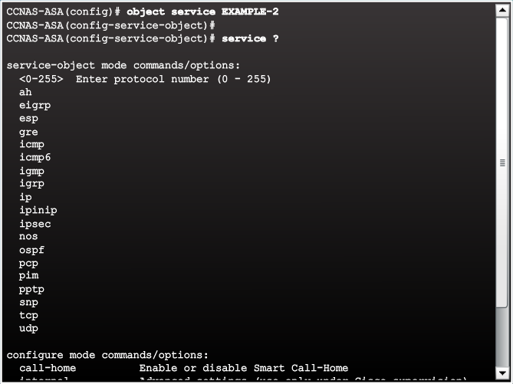
Configuring Service Objects
Service Object Options Example
To create a service object, use the object service object-name global configuration mode command. The prompt changes to service object configuration mode. The service object can contain a protocol, ICMP, ICMPv6, TCP, or UDP port (or port ranges).
Figure 1 displays service options available.
Notes:
9.2.3.3 Configuring Service Objects

Slide 45


Configuring Service Objects (Cont.)
Common Service Object Commands
Figure 3 displays a sample service object configuration. A service object name can only be associated with one protocol and port (or ports). If an existing service object is configured with a different protocol and port, the new configuration replaces the existing protocol and port with the new ones.
Configuring a Service Object Example
Notes:
9.2.3.3 Configuring Service Objects (Cont.)

Slide 46

Object Groups
Objects can be grouped together to create an object group. By grouping like objects together, an object group can be used in an access control entry (ACE) instead of having to enter an ACE for each object separately.
The ASA supports various types of object groups as described in the figure.
Notes:
9.2.3.4 Object Groups

Slide 47


Configuring Common Object Groups
Network Object Group Example
ICMP-type Object Group Example
Notes:
9.2.3.5 Configuring Common Object Groups

Slide 48

Configuring Common Object Groups (Cont.)
Services Object Group Example
Notes:
9.2.3.5 Configuring Common Object Groups (Cont.)
9.2.3.6 Activity – Identify Types of Object Groups

Slide 49
Configuring Common Object Groups (Cont.)
Services Object Group Example
Notes:
9.2.3.5 Configuring Common Object Groups (Cont.)
9.2.3.6 Activity – Identify Types of Object Groups

Slide 50
Topic 9.2.4: ACLS
The Cisco ASA 5505 provides basic traffic filtering capabilities with ACLs. ACLs control access in a network by preventing defined traffic from entering or exiting.
There are many similarities between ASA ACLs and IOS ACLs. For example, both are made up of ACEs, processed sequentially from the top down, and there is an implicit deny any at the bottom. Additionally, the rule of only one ACL per interface, per protocol, per direction, still applies.

Slide 51


ASA ACLs
ASA ACL and IOS ACL Similarities
ASA ACL and IOS ACL Similarities
Notes:
9.2.4.1 ASA ACLs

Slide 52


Types of ASA ACL Filtering
ASA devices differ from their router counterparts because of interface security levels. By default, security levels apply access control without an ACL configured. For instance, traffic from a more secure interface, such as security level 100, is allowed to access less secure interfaces, such as level 0. Traffic from a less secure interface is blocked from accessing more secure interfaces.
Higher Levels Allowed To Lower Levels
Lower Levels Denied To Higher Levels
Notes:
9.2.4.2 Types of ASA ACL Filtering

Slide 53



Types of ASA ACLs
Extended ACL Examples
Standard ACL Example
IPv6 ACL Example
Notes:
9.2.4.3 Types of ASA ACLs

Slide 54

Configuring ACLs
ACL Command Parameters
Notes:
9.2.4.4 Configuring ACLs

Slide 55

Configuring ACLs (Cont.)
Condensed Extended ACL Syntax
Notes:
9.2.4.4 Configuring ACLs (Cont.)

Slide 56


Configuring ACLs (Cont.)
ASA ACL Elements
Notes:
9.2.4.4 Configuring ACLs (Cont.)

Slide 57

Applying ACLs
access-group Command Syntax
Notes:
9.2.4.5 Applying ACLs

Slide 58

ACLs and Object Groups
ACL Reference Topology
Notes:
9.2.4.6 ACLs and Object Groups

Slide 59


ACLs and Object Groups (Cont.)
Extended ACL Configuration Example
Verifying the ACL
Notes:
9.2.4.6 ACLs and Object Groups (Cont.)

Slide 60


ACL Using Object Groups Examples
Condensed Extended ACL Syntax with Object Groups
ACL Reference Topology
Notes:
9.2.4.7 ACL Using Object Groups Examples

Slide 61


ACL Using Object Groups Examples
ACL and Object Group Configuration Example
Verifying the ACL and Object Group Configuration Example
Notes:
9.2.4.7 ACL Using Object Groups Examples

Slide 62
Topic 9.2.5: NAT Services on an ASA

Slide 63

ASA NAT Overview
Types of NAT Deployments:
Inside NAT
Outside NAT
Bidirectional NAT
Notes:
9.2.5.1 ASA NAT Overview

Slide 64

Configuring Dynamic NAT
Dynamic NAT Reference Topology
Notes:
9.2.5.2 Configuring Dynamic NAT

Slide 65



Configuring Dynamic NAT (Cont.)
Dynamic NAT Configuration Example
Enable Return Traffic Example
Verifying the Dynamic NAT Configuration Example
Notes:
9.2.5.2 Configuring Dynamic NAT (Cont.)

Slide 66


Configuring Dynamic PAT
Dynamic PAT Configuration Example
Verifying the Dynamic PAT Configuration Example
Notes:
9.2.5.3 Configuring Dynamic PAT

Slide 67


Configuring Static NAT
Configure the DMZ Interface Example
Static NAT Configuration Example
Notes:
9.2.5.4 Configuring Static NAT

Slide 68

Configuring Static NAT (Cont.)
Verifying the Static NAT Configuration Example
Notes:
9.2.5.4 Configuring Static NAT (Cont.)

Slide 69
Topic 9.2.6: AAA

Slide 70

AAA Review
Notes:
9.2.6.1 AAA Review

Slide 71


Local Database and Servers
RADIUS and TACACS+ Server Commands
Sample AAA TACACS+ Server Configuration
Notes:
9.2.6.2 Local Database and Servers

Slide 72

AAA Configuration
Notes:
9.2.6.3 AAA Configuration

Slide 73
Topic 9.2.7: Service Policies on an ASA

Slide 74




Overview of MPF
A Modular Policy Framework (MPF) configuration defines a set of rules for applying firewall features, such as traffic inspection and QoS, to the traffic that traverses the ASA. MPF allows granular classification of traffic flows, to apply different advanced policies to different flows.
Notes:
9.2.7.1 Overview of MBF

Slide 75

Configuring Class Maps
Notes:
9.2.7.2 Configuring Class Maps

Slide 76

Define and Activate a Policy
Implementing Modular Policy Framework
Notes:
9.2.7.3 Define and Activate a Policy

Slide 77


ASA Default Policy
Default Service Policy Configuration
Notes:
9.2.7.4 ASA Default Policy

Slide 78
Section 9.3: Summary
Chapter Objectives:
Explain how the ASA operates as an advanced stateful firewall.
Implement an ASA firewall configuration.
Notes:
9.3.1.1 Packet Tracer – Configure ASA Basic Settings and Firewall Using CLI
9.3.1.2 Lab – Configure ASA Basic Settings and Firewall Using CLI
9.3.1.3 Chapter 9: Implementing the Cisco Adaptive Security Appliance

Slide 80


Instructor Resources
Remember, there are helpful tutorials and user guides available via your NetSpace home page. (https://www.netacad.com)
These resources cover a variety of topics including navigation, assessments, and assignments.
A screenshot has been provided here highlighting the tutorials related to activating exams, managing assessments, and creating quizzes.
1
2
Notes:
https://www.netacad.com

